Slide 1
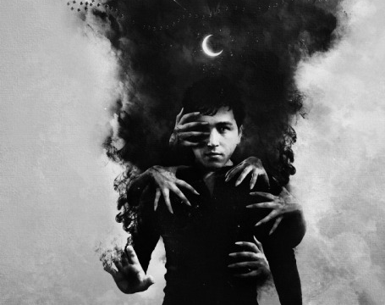
My Inner Demons
A game developed by Corrie, Joshua, Nathan and James
20/21 GAME DEVELOPMENT PROJECT

Slide 2
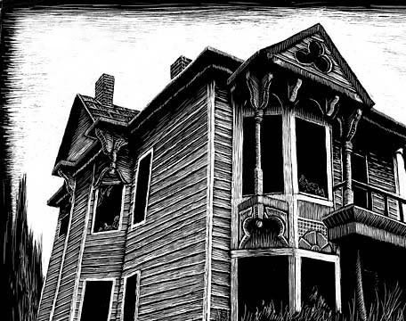
CORE CONCEPT
The game is going to be a first person horror/mystery game on PCs.
The game will have a dark and religious theme/environment for its core, which the player will have to face their fears explore, gather information on what's happening to himself, how to solve it and escape to complete the game.

Slide 3
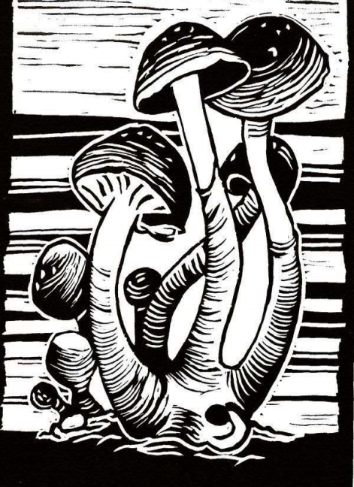
STORY
The player wakes up in a cabin feeling different than usual, and he soon realizes that his been cursed by an ancient demon. As the game progresses the effects of the curse become stronger and more noticeable, with the curse slowly turning the player into a demon.
To delay the curse from completing, the player can find and consume psychedelic drugs, which will buy the player some time in the cost of increasing the transformation effects that the player is suffering from.
The player needs to find a way to break the curse and escape before the curse resolves.

Slide 4
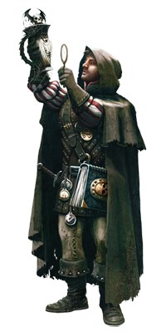
PLAYER CHARACTER
The player’s character doesn’t have a way to defend himself from the horrors that hunt him, other than running around and hiding.
His only strength is his investigating abilities, which will provide him useful information on how to deal with what's hunting him and how he is going to break the curse and escape.

